Slide 1
TRANSFORMATION MATRIX
Transformation Matrix is a matrix that transforms one vector into another vector by the process of matrix multiplication. The transformation matrix alters the cartesian system and maps the coordinates of the vector to the new coordinates

Slide 2
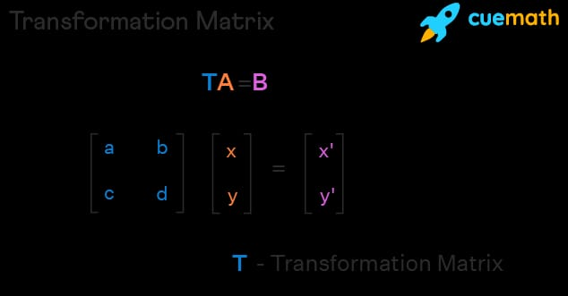

Slide 3
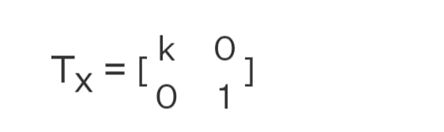
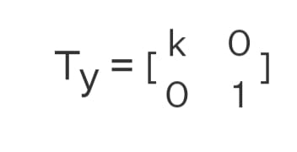
STREACHING/scaling
The linear transformation enlarges the distance in the xy plane by a constant value. Here the distance is enlarged or compressed in a particular direction with reference to only one of the axis and the other axis is kept constant. A stretch along the x-axis by keeping the y-axis the same is x' = kx, and y' = y. Here k is a constant numeric value and for k > 1 it is a stretch, k < 1 it is a compression, and for k = 1 it is the same point. The transformation matrix for a stretch along the x-axis is as follows.
Also, we can stretch along the y-axis to obtain x' = x, and y' = ky. The transformation matrix for a stretch along the y-axis is as follows.

Slide 4
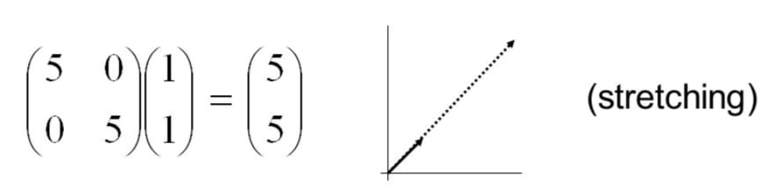
Scaling example

Slide 5


ROTATION
The transformation matrix helps to rotate the vector in an anticlockwise direction at an angle θ. The transformation matrix
transforms the vector xi + yj to x'i + y'j, which is represented as follows.

Slide 6
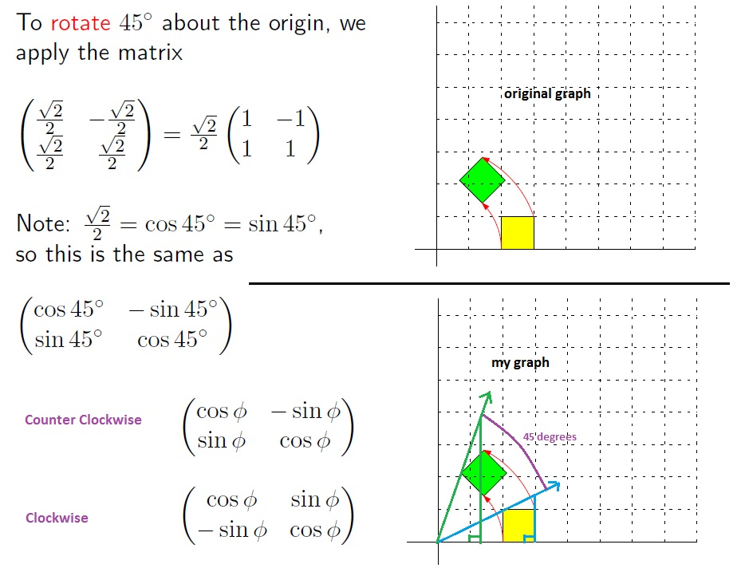

Slide 7
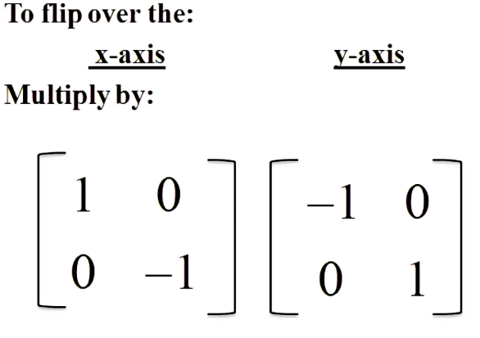
Reflection
Reflection Matrix It is also called a flip matrix. Reflection is the mirror image of the original object. In other words, we can say that it is a rotation operation with 180°. In reflection transformation, the size of the object does not change. It can be represented in matrix form as

Slide 8
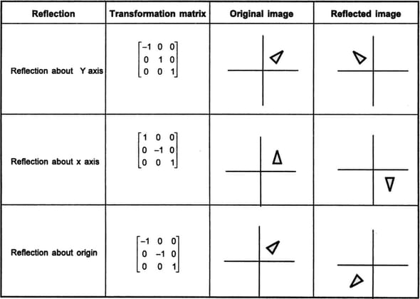

Slide 9
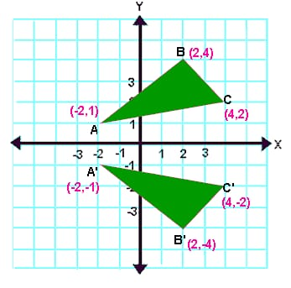

Slide 10
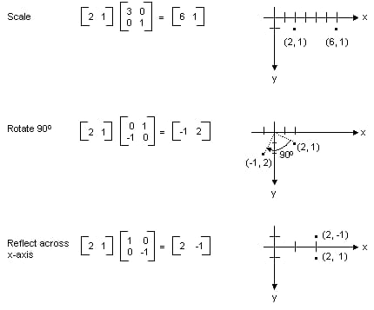

Slide 11
Translation (defination0
A translation slides an object a fixed distance in a given direction. The original object and its translation have the same shape and size, and they face in the same direction. It is a direct isometry.
In simple words, translation means, it just moves the given figure without rotating, re sizing or anything else.

Slide 12
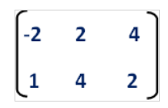
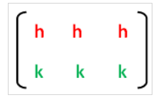
Translation Rule Using Matrix
Let A (-2, 1), B (2, 4) and (4, 2) be the three vertices of a triangle. First we have to write the given vertices in matrix form as given below.
If the given figure is translated "h" units on the x-axis and "k" units on the y-axis, then the translation transformation matrix will be as given below.

Slide 13
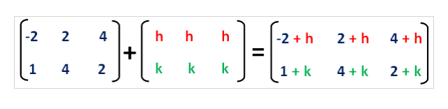
And we can get the vertices of the translated image using the matrix shown below.
Vertices of the translated image are
(-2+h, 1+k), (2+h, 4+k), (4+h, 2+k)

Slide 14
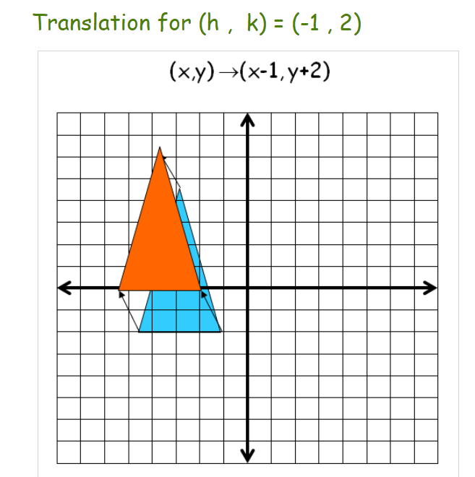

Slide 15


shearing
The shearing changes the vector in such a way that the square boxes in the coordinate axes are deformed into parallelograms. The transformation matrix for shearing along the x-axis is
and it transforms the vector A = xi + yj to A' = x'i + y'j such that x' = x + ky, y' = y. This transformation can be understood from the below multiplication of matrices.

Slide 16
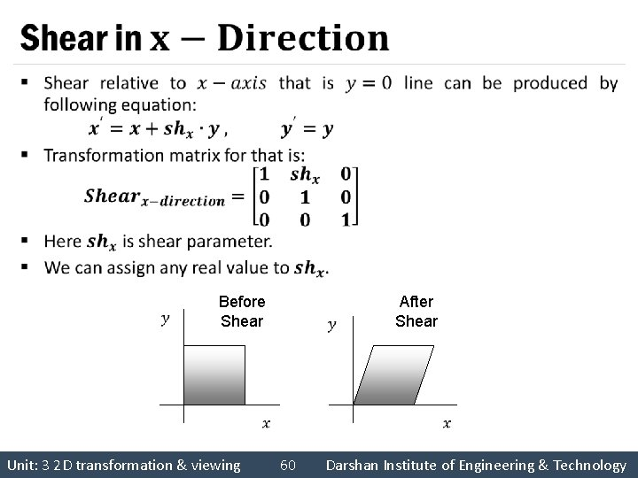

Slide 17
Applications of transformation matrix-
The following are some of the important applications of the transformation matrix.
1. Vectors represented in a two or three-dimensional frame are transformed to another vector.
2. Inverse Space also use matrix transformations.
3. Dot Product and Cross Product of Vectors
4. Change of Basis of vectors is possible through transformations
5. Eigen Vectors and Eigen Values involve matrix and matrix transformation.

Slide 18
Thank you…

